Slide 1
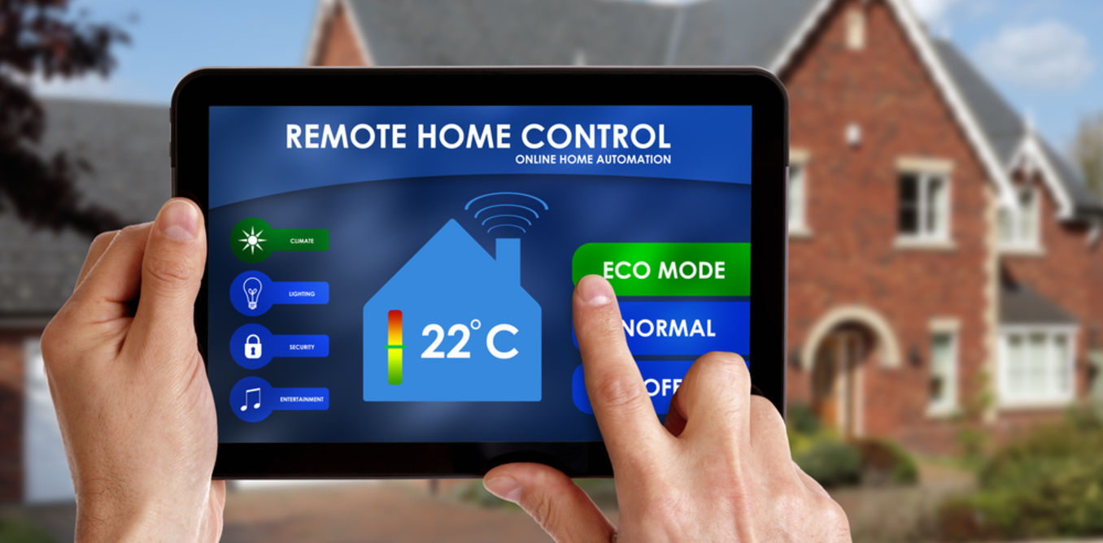
smart space technology
BY,
K.JANARTHANAN,
ECE 3rd year,
SCADCET.

Slide 2
agenda
What is smart space
Technology used in smart space
Segment of smart space
Merits
Demerits
Application
Project explanation.

Slide 3
question
Are you like ordinary person or smart person ?

Slide 4
What is smart space
smart space is known as “physical location equipped with networked sensor to give better information about the current condition of these locations to the owner or authority”.
An owner or an authority may be a human or else machine.
EXMAPLE :
From a building with networked temperature and motion sensors to a vehicle that constantly reports its location, performance and maintenance needs.

Slide 5
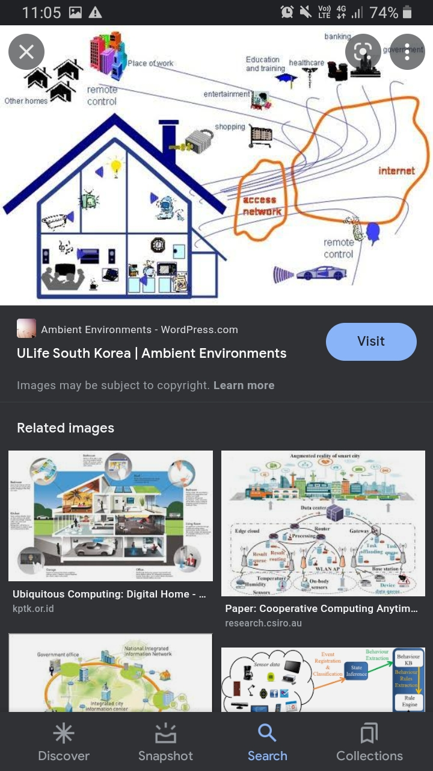

Slide 6
Technology's in smart space
Virtual Computing Environment:
The virtual computing environment layer allows smart device access to the internet, or private network services, that allow them to connect to other parts of the distributed systems that powers the smart space environment.
Physical Environment:
The physical environment layer is the most varied layer of smart spaces, and includes embedded sensors, microprocessors, tracking tags, and the other physical aspects of the smart space.
Human-Environment:
Devices that accompany with people fill this layer. This means humans can make up smart space environments through smart devices. smartphones, wearable smart devices, pacemakers
Using this multi-layered approach to make smart space environments (virtual, physical, and human layers), we can categorize smart enabling technologies according to their function.

Slide 7
Virtual environment
Connectivity and control technologies enable the virtual aspect of smart space environments.
Connectivity- wireless, 4/5G cellular, Bluetooth, Wi-Fi, ZigBee, etc.
Control- AI and automation software, operating locally or in the cloud, can work through the remaining physical and human layer devices, collecting and processing data to create the 'smart' effect.
Common virtual layer technologies include:
1.Artificial Intelligence
2. Machine Learning
3.Computer Vision
4.Speech Recognition
5.Cloud computing / Distributed systems
6.Wireless Connectivity

Slide 8
Physical environment
Data capture is an integral aspect of smart spaces and is needed to feed information to the smart algorithms to make intelligent decisions about changing conditions.
Primarily, sensor devices provide the means to fill the data pipeline within the location. But, in the example of smart factories, global data may be factored into local decisions.
Technologies deployed in the physical layer include:
Sensors
RFID tagging
Microprocessors

Slide 9
Human-Environment
In human environment, smart devices are interfaces between humans and smart spaces.
new technology is opening opportunities for developers to build for a different class of smart consumers. The following lists common human smart devices, and possible future interfaces that could change how we think about smart spaces, especially in the medical sector.
Smartphones, watches,Closed-loop insulin delivery systems,Smart inhalers,Smart pacemakers

Slide 10


Slide 11
segment of smart spaces
1. Smart Homes:
Smart homes are built on the idea of incorporating intelligent technologies into residential spaces that aim to enhance the quality of life.
this idea is a favorable solution for significant concerns towards energy consumption and environmental impacts.
It provide consistent monitoring and controlling for the patients.
it is capable of observing the behaviors of residents and activities with the help of sensors and actuators used throughout the unit.
The significant potential of smart homes in automation and digitalization of living environments and the incorporated technological units is extensively accepted.

Slide 12
2.Smart Buildings:
Advanced technologies like the Internet of Things (IoT), Big Data, and intelligent Building Management Systems (iBMS) are changing the manner in which new buildings are built and designed.
With the help of advanced use of data and analytics, smart buildings facilitate interactions, sharing of knowledge, and enhance the performance of a business.
Moreover, smart buildings enable superior, more effective utilization of space and environments.

Slide 13
Merits using smart space tech:
Environmental benefits
cost savings
Risk mitigation
safer
smarter experience

Slide 14
Demerits:
Hacking
Iinstallation cost is high.

Slide 15
Automotive HUMAN DETECHED temperature controlled motor
automotive human detected temperature controlled motor project is most reliable to smart space technology.
It depends on surrounding physical quantity. There are motion and temperature.
The sensor was used measure the these physical quantity.
For motion detection we use passive infrared sensor(pir) and thermistor was used temperature detection.

Slide 16
Pir sensor | thermistor
Input voltage -4.5 v to 20 v. | thermistor is a electronic device . The resistance value is changed based on the temperature
Current -50 micro amps | For 10K thermistor, at normal temperature resistance is 10K ohm. In warming temperature, the resistance value is decreased 9.3 k ohm
Current -50 micro amps
Sensing range – 7 meters
Operating temperature- 15 to 70 c

Slide 17
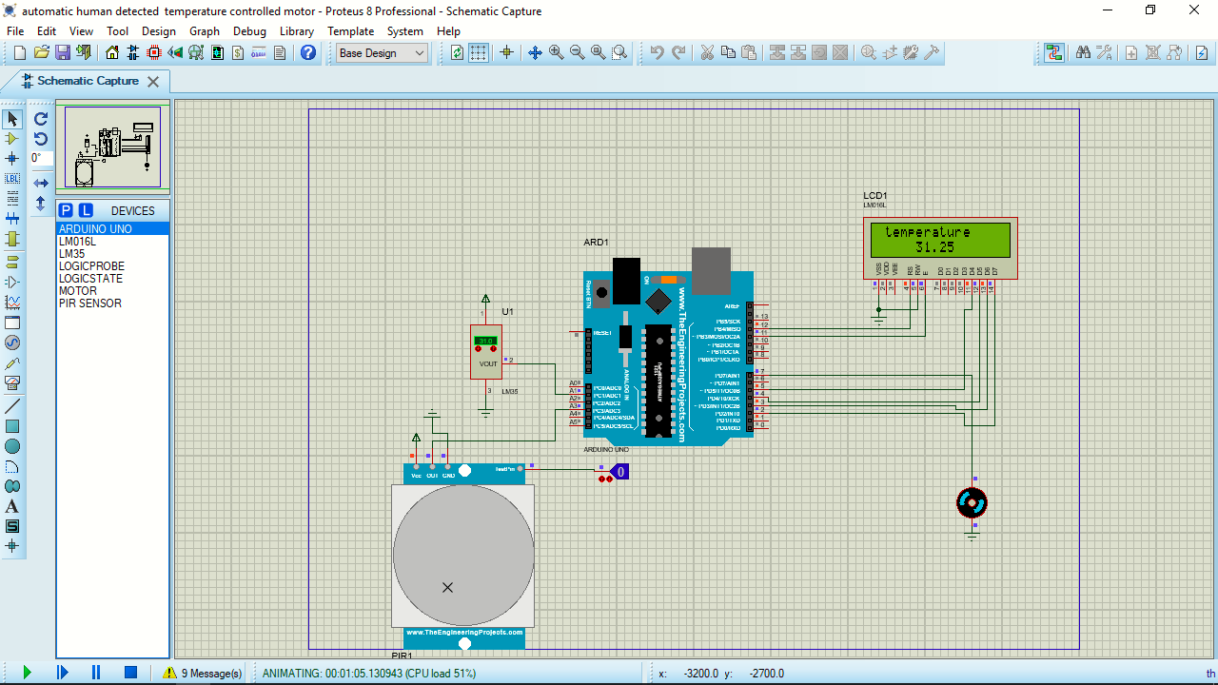
When the move able object not presented in mentionable distance(coverage area) , then the motor should be off.

Slide 18
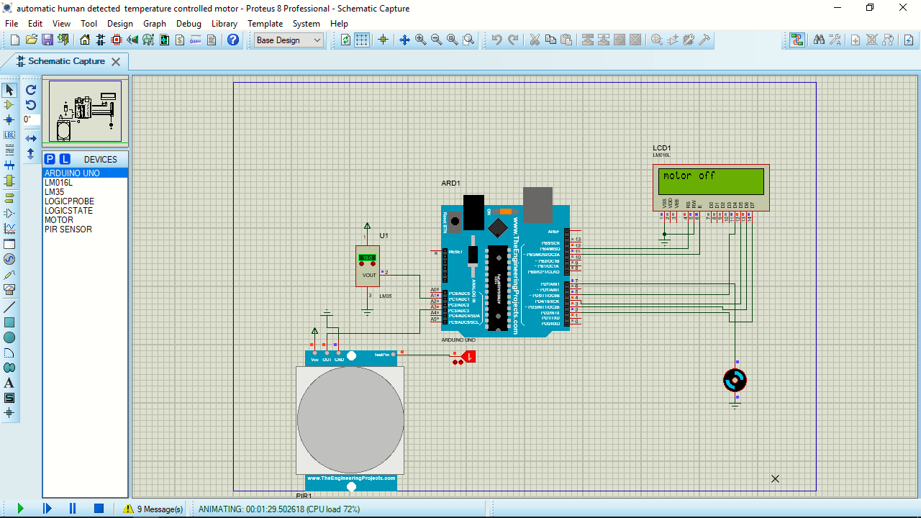
Condition 1:
1.A moveable object presented in some mentionable distance. So ,the motor should be run.
2. Then the surrounding temperature is decide the level of voltage. The temperature is below the cut-off(20) value the motor should be off .

Slide 19

Condition 2:
Now the temperature is above the cut off (20C)value so motor is running but below the cutoff1 (23C) value
voltage regulated 1:5. speed is 20 percent

Slide 20

Condition 3:
the temperature value in between cut off 1(23C) and cut-off 2 (25C)
the voltage was regulated 2:5.

Slide 21

Condition 4:
the temperature value is between cut-off 2(25C) and cut-off 3(28C)
the voltage was regulated 3:5. motor speed is 60 percent.

Slide 22

Condition 5:
the temperature value is between cutoff 3 and cutoff 4 the voltage was regulated 4:5. the motor speed is 80 percentage

Slide 23
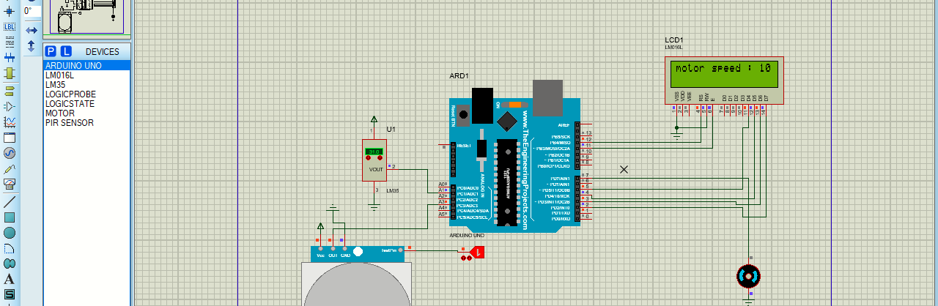
Condition 6:
the temperature value is between cutoff 4 and cutoff 5 the voltage was regulated 5:5. the motor speed 100%

Slide 24
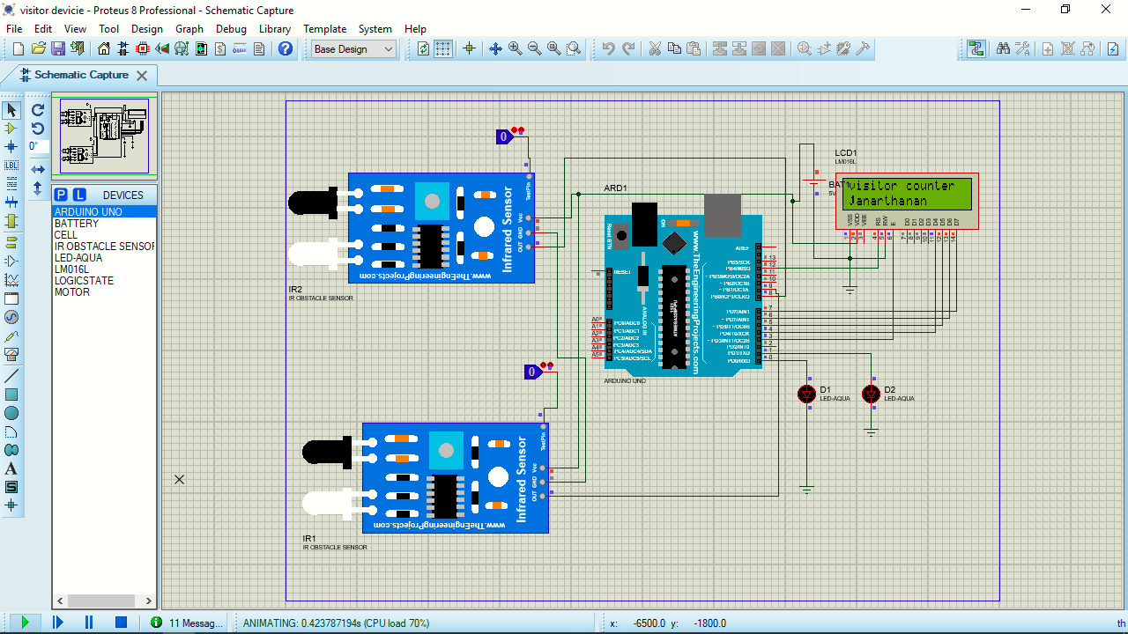
COUNTER BASED SWITCHING
IN THIS PROJECT, IR SENSOR USED AS A COUNTER TO COUNT THE NUMBER OF HUMANS IN THE ROOM.
BASED ON THE NUMBER OF HUMANS LIGHTS AND FANS ACTIVATED.

Slide 25

THE COUNTER VALUE IS BELOW THE CUTOFF VALUE , THEN SOME LIGHTS AND FANS ACTIVATED.

Slide 26

COUNTOR VALUE IS REACHED ABOVE CUTOFF VALUE, THEN ALL LIGHTS AND FANS ACTIVATED.

Slide 27
Thank you all…………

